Slide 1
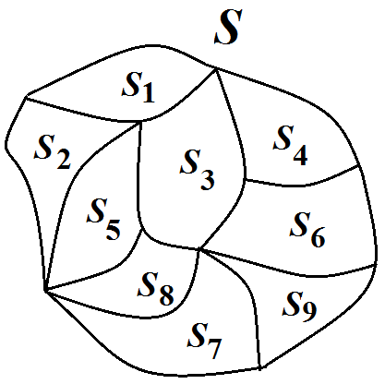
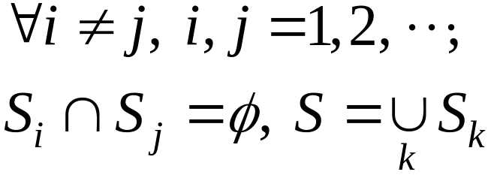
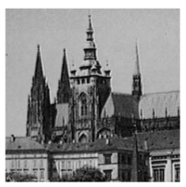
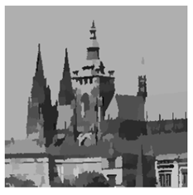
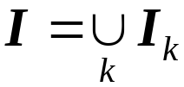
Chapter 9: Image Segmentation
– Partition an image into component parts
。 Mathematical Partition
。 Image Segmentation
Image
I
Segmentation
9-<number>

Slide 2
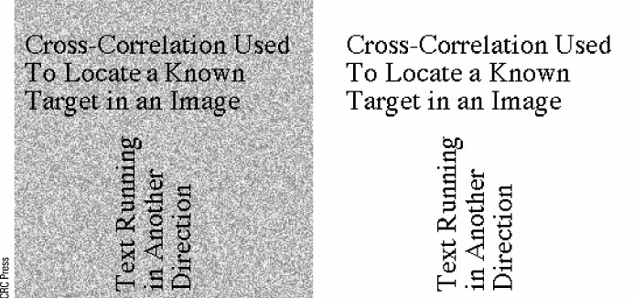
。Advantages:
(i) Remove unnecessary details
(ii) Bring out significant portions
Example:
9-<number>

Slide 3
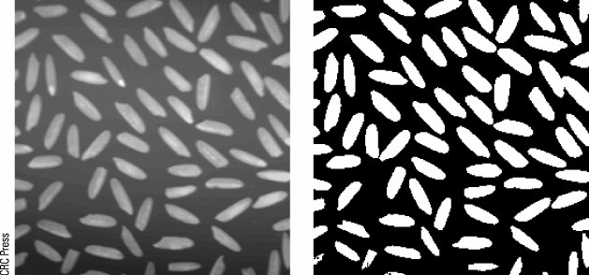
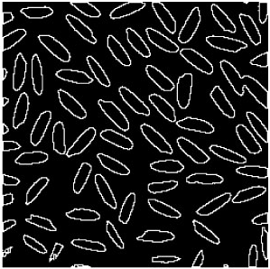
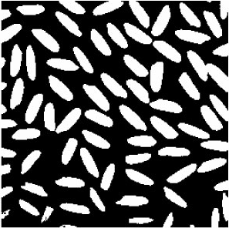
Fundamental approaches:
(1) Thresholding
(2) Edge detection
9-<number>

Slide 4
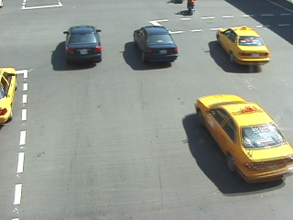

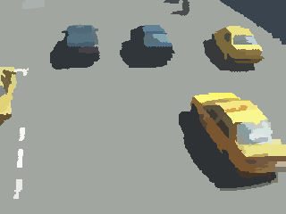
(3) Region-based segmentation
Split
Merge

Slide 5
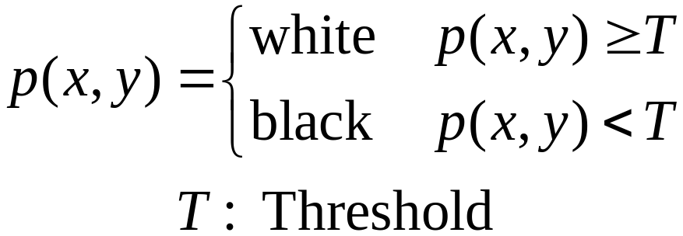
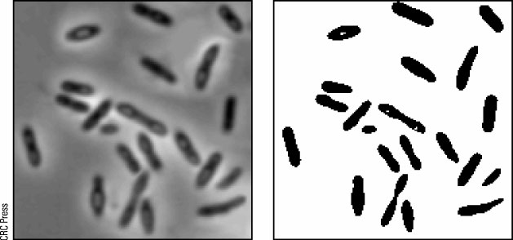
◎ Thresholoding
。 Single Thresholoding
Example:
9-<number>

Slide 6
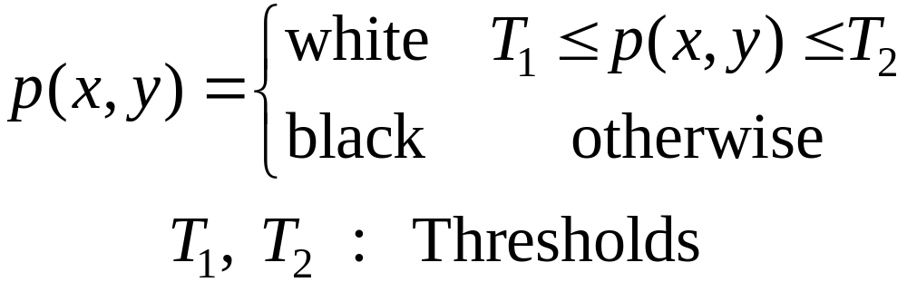
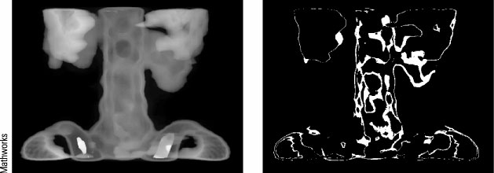
。 Double Thresholding
Example:
9-<number>

Slide 7
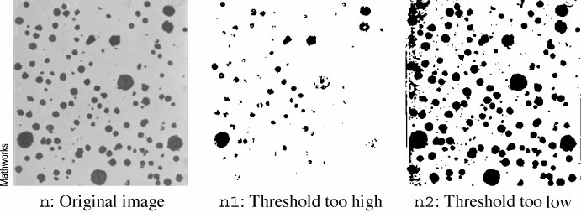
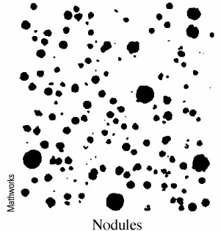
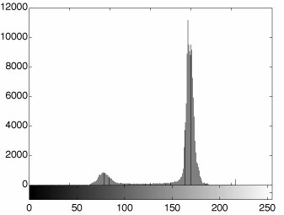
○ How to choose a threshold value
。 Histogram method
9-<number>

Slide 8
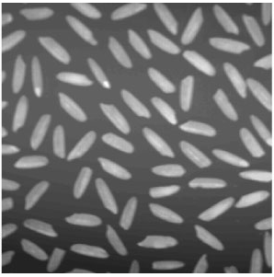
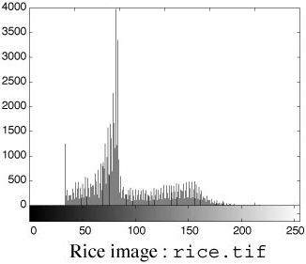

。 Otsu’s thresholding method
Describe the histogram as a probability
distribution by
9-<number>

Slide 9
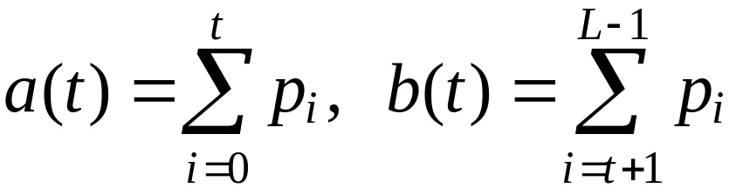
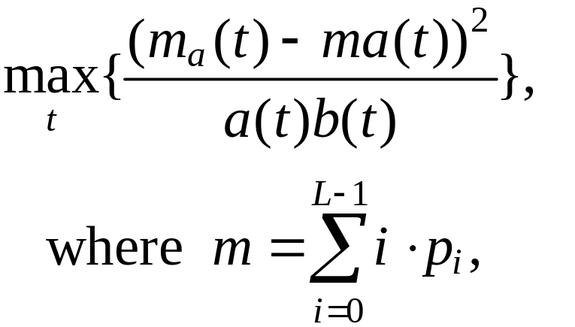
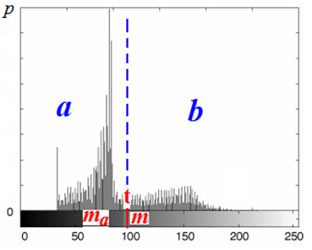
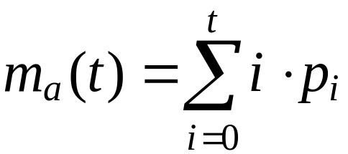
Let t be the determined threshold value
(t unknown so far).
Define
Find t such that
9-<number>

Slide 10
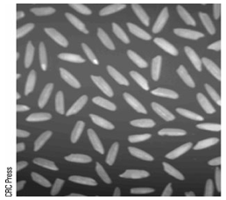
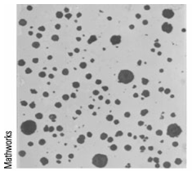
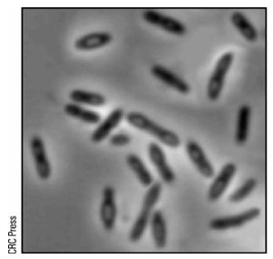
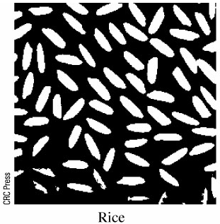
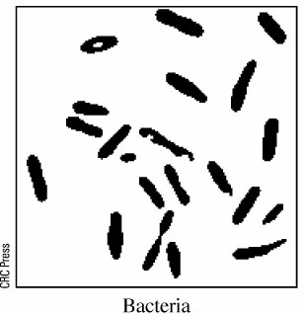
9-<number>

Slide 11
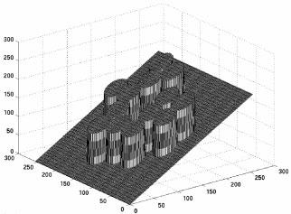
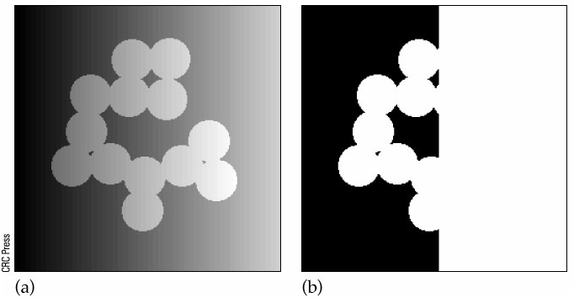
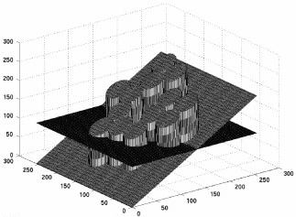
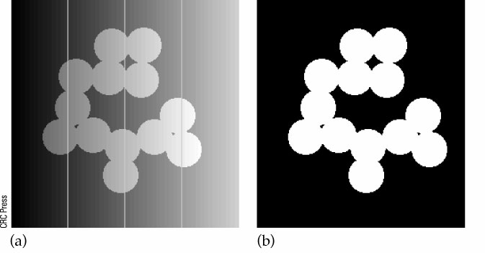
Adaptive Thresholding
Divide image into strips
Apply Otsu’s method to each strip
9-<number>

Slide 12
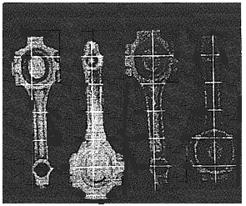
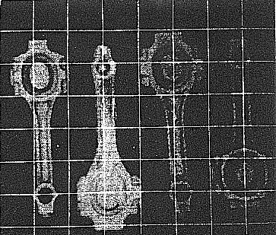

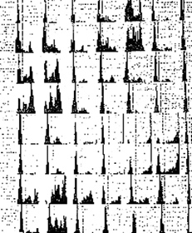
。 Variable thresholding
(i) Divide image into blocks
(ii) Compute histograms
of block images
9-<number>

Slide 13
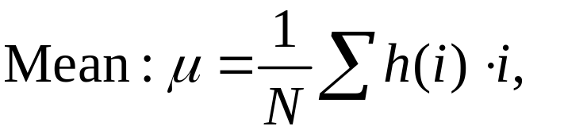
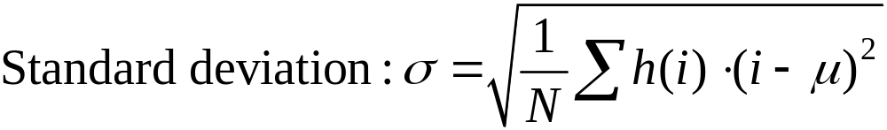


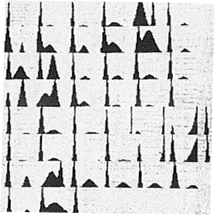
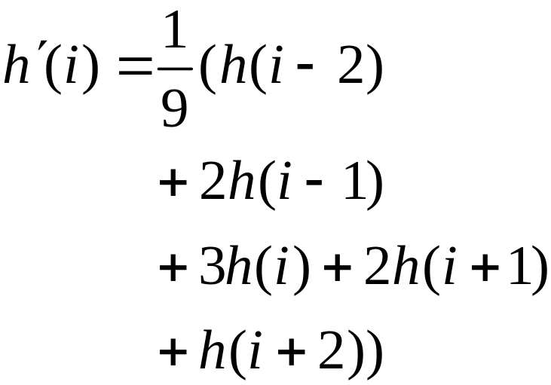
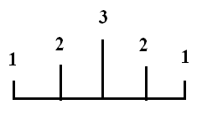
For each block image, compute its
(1) Smooth histogram h
9-<number>

Slide 14

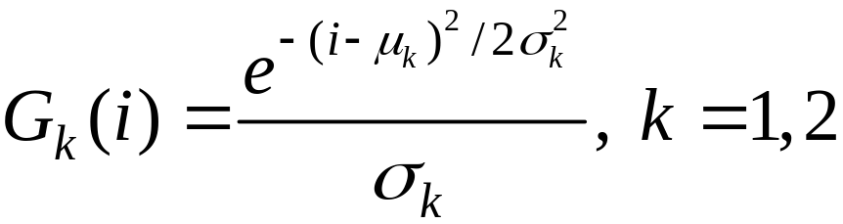

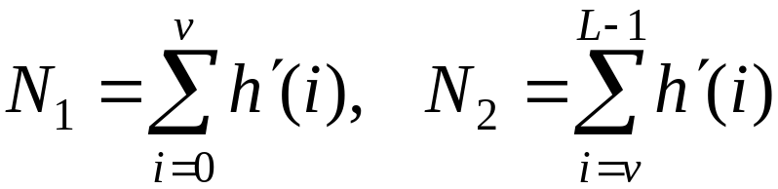
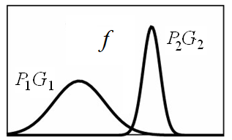
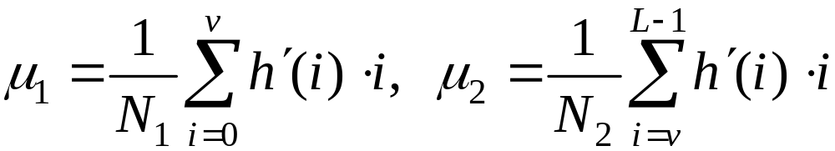
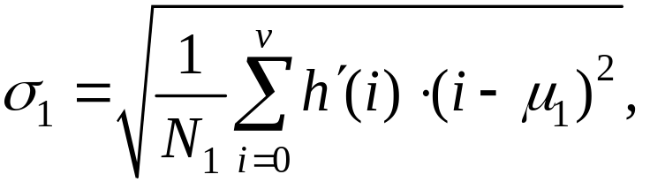
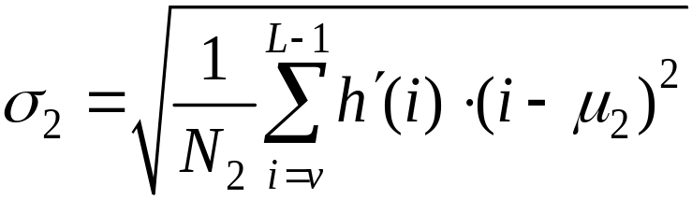
(2) Fit with mixture of Gaussian
EM algorithm
9-<number>

Slide 15
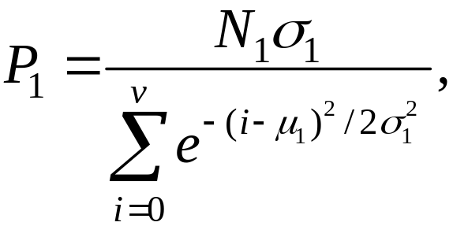
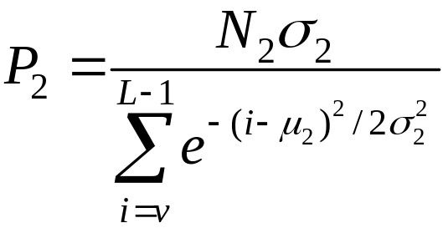

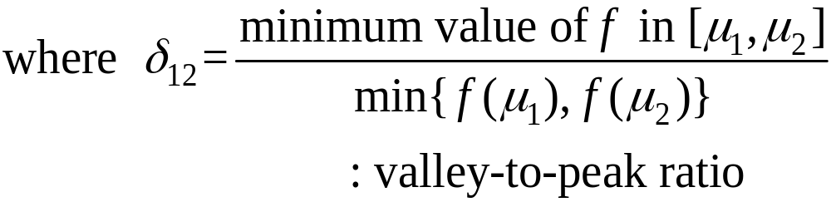


where v is the gray level corresponding to the deepest valley of
(3) Test bimodality
9-<number>

Slide 16



(4) If the bimodality test is past, compute T by
(5) For block (x,y) whose threshold value T(x,y)
hasn’t yet been determined
9-<number>

Slide 17



(6) Smooth T by
(7) Determine thresholding
values of image pixels
by bilinear interpolation
9-<number>

Slide 18
Summary of variable thresholding
(1) Divide image into blocks
(2) Compute histograms of block images
For each block image, compute its mean and
standard deviation
(4) If standard deviation is large enough
(i) Smooth histogram
(ii) Fit histogram with mixture of Gaussian
(iii) Test bimodality
9-<number>

Slide 19
If the bimodality test is past, compute threshold
value
Determine the threshold values for the blocks
whose threshold values haven’t yet been
determined
(vi) Smooth the threshold value of blocks
Determine thresholding values of image
pixels by bilinear interpolation
9-<number>

Slide 20


Global thresholding
Variable thresholding
9-<number>

Slide 21









◎ Edge Detection
。 Types of edge:
Step edge (jump edge)
Ramp edge
Roof edge (crease edge)
Smooth edge
9-<number>

Slide 22



○ Derivatives
9-<number>

Slide 23



2-D case:
9-<number>

Slide 24






Prewitt filters (central difference + smooth)
。Central difference
Horizontal filter: , Smooth filter:
Combine
Vertical filter: , Smooth filter:
Combine
9-<number>

Slide 25



vertical
horizontal
Edge image Binary image Thinning
9-<number>

Slide 26




。Sobel filter:
。Roberts filter:
9-<number>

Slide 27




◎ Second Derivatives
Laplacian:
9-<number>

Slide 28



Laplacian Filter:
Invariant under rotation (isotropic filter)
9-<number>

Slide 29


Step edge:
Ramp edge:
9-<number>

Slide 30


。 Second derivatives are
sensitive to noise
。 Other Laplacian masks
9-<number>

Slide 31



○ Zero crossing
0 +, + 0
0 －, － 0
+ －, － +
9-<number>

Slide 32


Example: Edge detection by taking zero
crossings after a Laplace filtering
Marr-Hildreth method
Smooth the input image using a
Gaussian before Laplace filtering
9-<number>

Slide 33



。 Gaussian smooth + Laplace filtering
= Laplacian of Gaussian (LOG):
Gaussian:
LOG:
9-<number>

Slide 34


Mexican hat:
Difference of Gaussian (DOG):
9-<number>

Slide 35








◎ Canny edge detector
○ Steps: Let
1. Smoothing and Edge detection
(a) Horizontal direction
(b) Vertical direction
(c) Edge magnitude
9-<number>

Slide 36







2. Non-maximum suppression
(a) For each pixel p,
(b) Quantize to
0, 45, 90 or 135 degs.
(c) Along
p is marked if its edge magnitude
is larger than both its two neighbors
p is deleted otherwise
9-<number>

Slide 37



3. Hysteresis thresholding
For each marked pixel p,
(a) If > or
(b) If and p is adjacent to
an edge pixel
p is considered as an edge pixel
9-<number>

Slide 38





◎ Hough Transform
Objectives:
i) Highlight significant line features,
ii) Suppress unimportant line segments.
9-<number>

Slide 39









○ Line equation: y = ax + b
A point on the line
Rewrite as
Another point
on the line
Parameter space
9-<number>

Slide 40



○ Line equation in the polar coordinate system:
9-<number>

Slide 41
◎ Region-based Segmentation
○ Splitting and Merging
Split
Merge

Slide 42
Steps:
1. Equally divide the input image into 4
sub-images;
2. Compute the characteristics of each sub-image,
e.g., intensity, color, texture, variance, etc;
3. Repeatedly divide sub-images into
sub-sub-images if their characteristics are
significantly different;
4. Repeatedly merge adjacent sub-images if
their characteristics are similar enough.

Slide 43





Slide 44






Input Image
Region Boundary
Segmentation

